Slide 1

ACENKA
A CMS SCANNER

Slide 2
Acenka is a GUI-based website vulnerability scanner which scans websites that use Control Management Systems (CMS) like Wordpress, Drupal and Joomla .
It also shows server related misconfigurations such as open ports, os
versions etc.
The scanner performs extensive scans on the website to find the CMS used and possible vulnerabilities that can be reported and/or fixed.
These vulnerabilities include, but are not limited to:
Cross- Site Scripting (XSS)
SQL injection
Authentication
XXE
Clickjacking
HTML Injection
User Info Exposure
Local File Inclusion
Remote File Inclusion
Arbitrary File Inclusion
API Endpoint Injection
About Acenka

Slide 3

STEPS
Enter the target website.
Press the icon.
The scan will take some time and a small summary will be displayed on the webpage.
A detailed summary of the scan will be downloaded on your local machine.

Slide 4
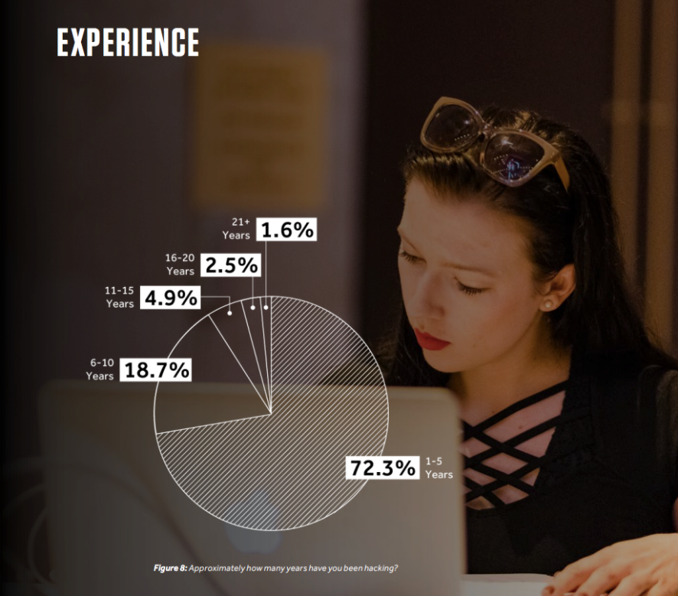
Usability
More than 70% of the infosec experts have the experience of 1-5 years.
Our application helps these experts and developers find security holes in their websites.
Our simple user interface enables anyone to check websites quickly and easily.

Slide 5
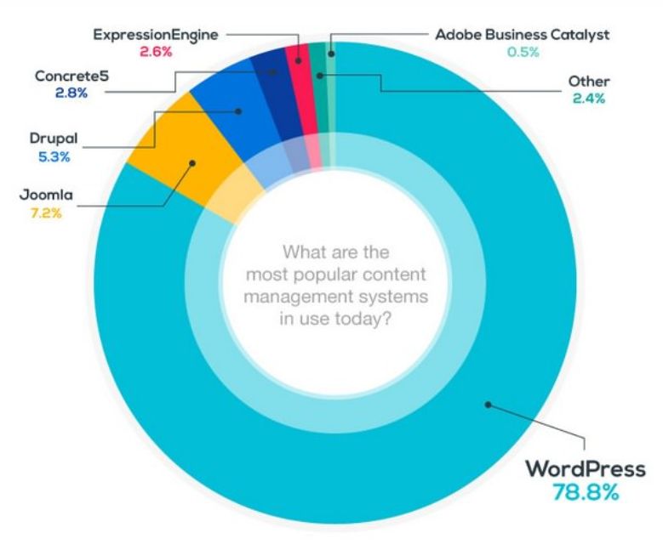
Usability
Wordpress, Joomla and Drupal are the top 3 CMS used in web development.
Each CMS has its own sets of vulnerabilities and APIs.
Fixing these vulnerabilities is a long process and complicated for new and upcoming developers.

Slide 6

Usability
More than 70% of the infosec experts work on websites as their main targets.
Our application scans websites for CMS vulnerabilities.
It also scans the network to give a broader outlook, including the hosting network of the website.

Slide 7
REQUIREMENTS
Absolutely nothing, just any browser that supports JavaScript. (Chrome, Firefox, etc)
Some patience is required as the report generation takes 3-4 minutes!

Slide 8
THANK YOU

